Slide 1
Principles of learning and how they apply to training and teaching

Slide 2
Collaborative Document
http://www.bit.ly/ELIXIR-TtT-Paris2020
Code of Conduct
We are all expected to follow a code of conduct:
https://elixir-europe.org/events/code-of-conduct
Course materials
https://github.com/TrainTheTrainer/ELIXIR-EXCELERATE-TtT

Slide 3
Introductions
Introductions set the stage for learning.
— Tracy Teal, Executive Director, The Carpentries

Slide 4
Challenge: your intro (3 min + 1 min for each of you)
Take 1 min to think about 3 keywords that represent you (could be adjectives, interests, research topics, personal characteristics, etc)
Introduce yourself telling us:
your name
your affiliation / country
The 3 keywords representing you
One thing you are proud of from the last month

Slide 5
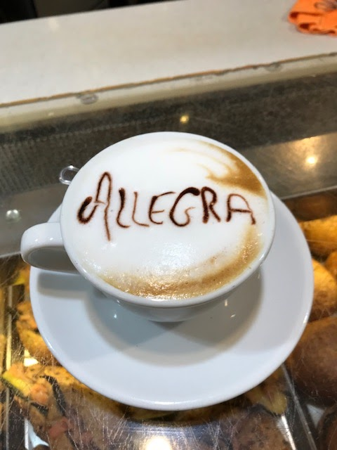



Introductions
Master Degree in Theoretical Physics
PhD in Bioinformatics
Training/Teaching
ELIXIR
Best practices in Software development
Software Carpentry
Carpentries Instructor Training
Learning processes/educational psychology
Cognitive sciences and learning
ELIXIR-EXCELERATE TtT programme
allegra.via@gmail.com
allegra.via
elixir_ita

Slide 6
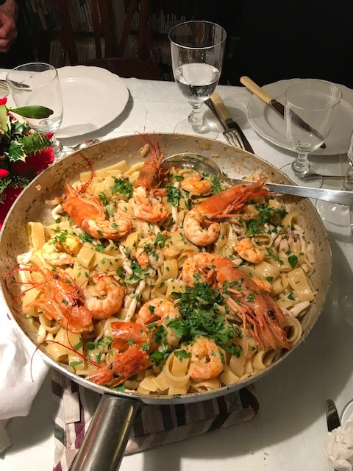

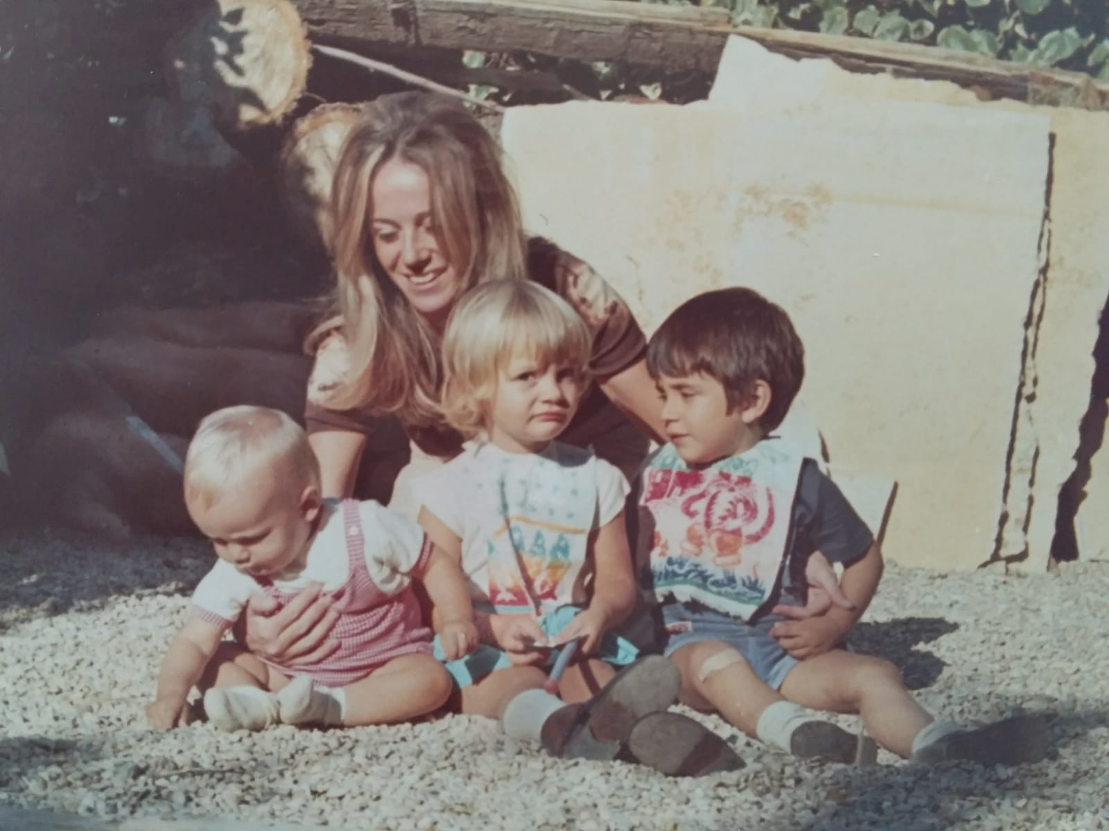



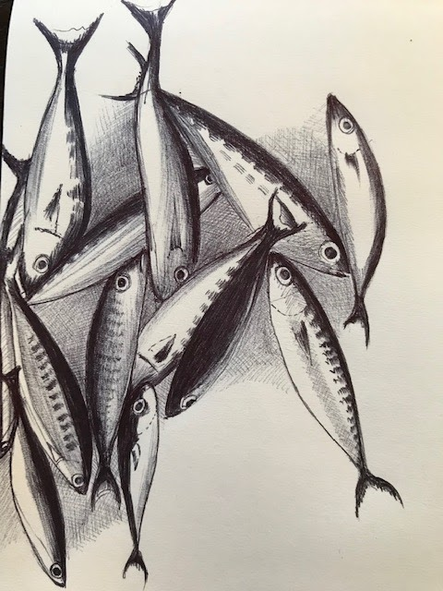


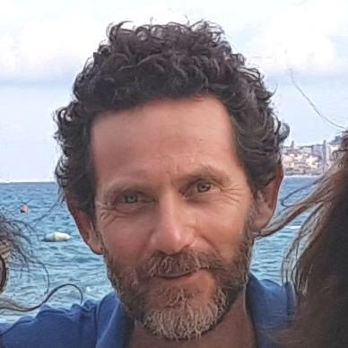




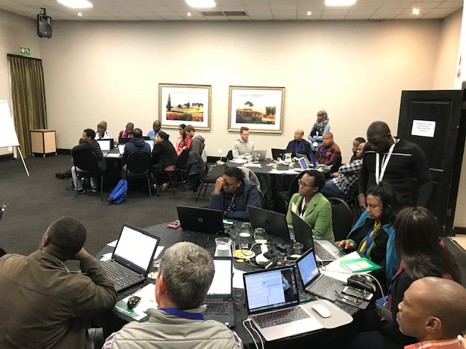

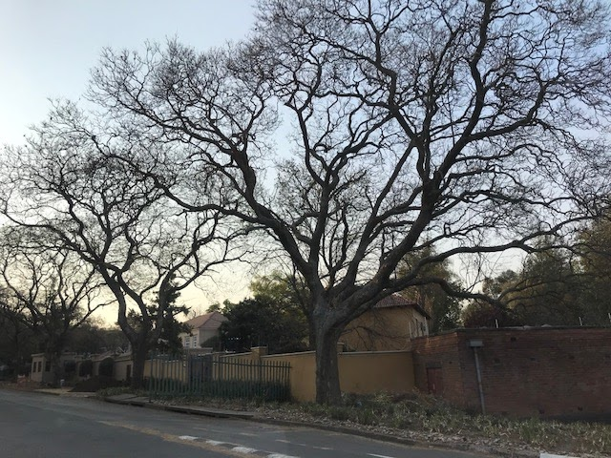



Slide 7
Challenge: Your expectations (3 min)
Write your expectations:
What do you expect to take home from this course?

Slide 8
Schedule
Day 1
9:00 Introductions&ELIXIR
9:30 Morning session: Learning principles and how they apply to training and teaching
12:30 Lunch break
14:00 Afternoon session: Training techniques to enhance learner engagement and participation
17:45 Wrap up of the day
18:00 End of day
Day 2
9:00 Morning session: Session, course, and materials design
12:30 Lunch break
13:30 Afternoon session: Assessment and feedback in training
15:45 Wrap up and feedback questionnaire
16:00 End of course

Slide 9

Session 1 Principles of learning and how they apply to training and teaching
How do people learn?
How does learning work?

Slide 10
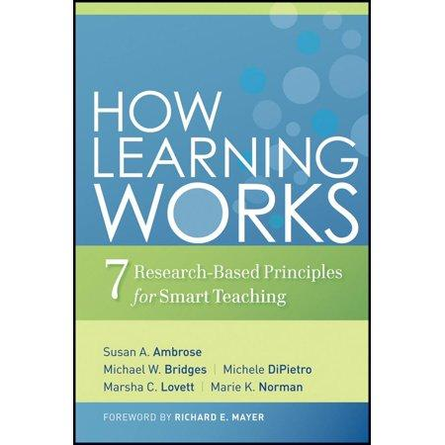
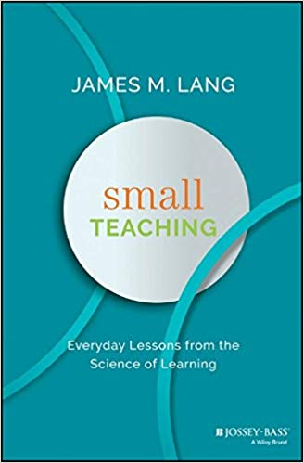


Resources to learn more about how learning works
https://www.learningscientists.org
the Carpentries instructor training materials
http://carpentries.github.io/instructor-training/

Slide 11
Challenge (3 min + 5 min)
How do you go about learning something new ?
How do you approach learning new things?
Which is the most effective approach for you to learn?
- Read about it
- Attend a training session !
- Have a go ?
- Do, reflect, process, further understand?
Make a list of three approaches that work for you when you want to learn something new (from the most to the less effective one);
Discuss it with your partner and compare.

Slide 12
Challenge
What is learning in your opinion/experience? (5 min)
Discuss with a partner and write in the GDoc one or more definitions of what is learning in your opinion/experience

Slide 13
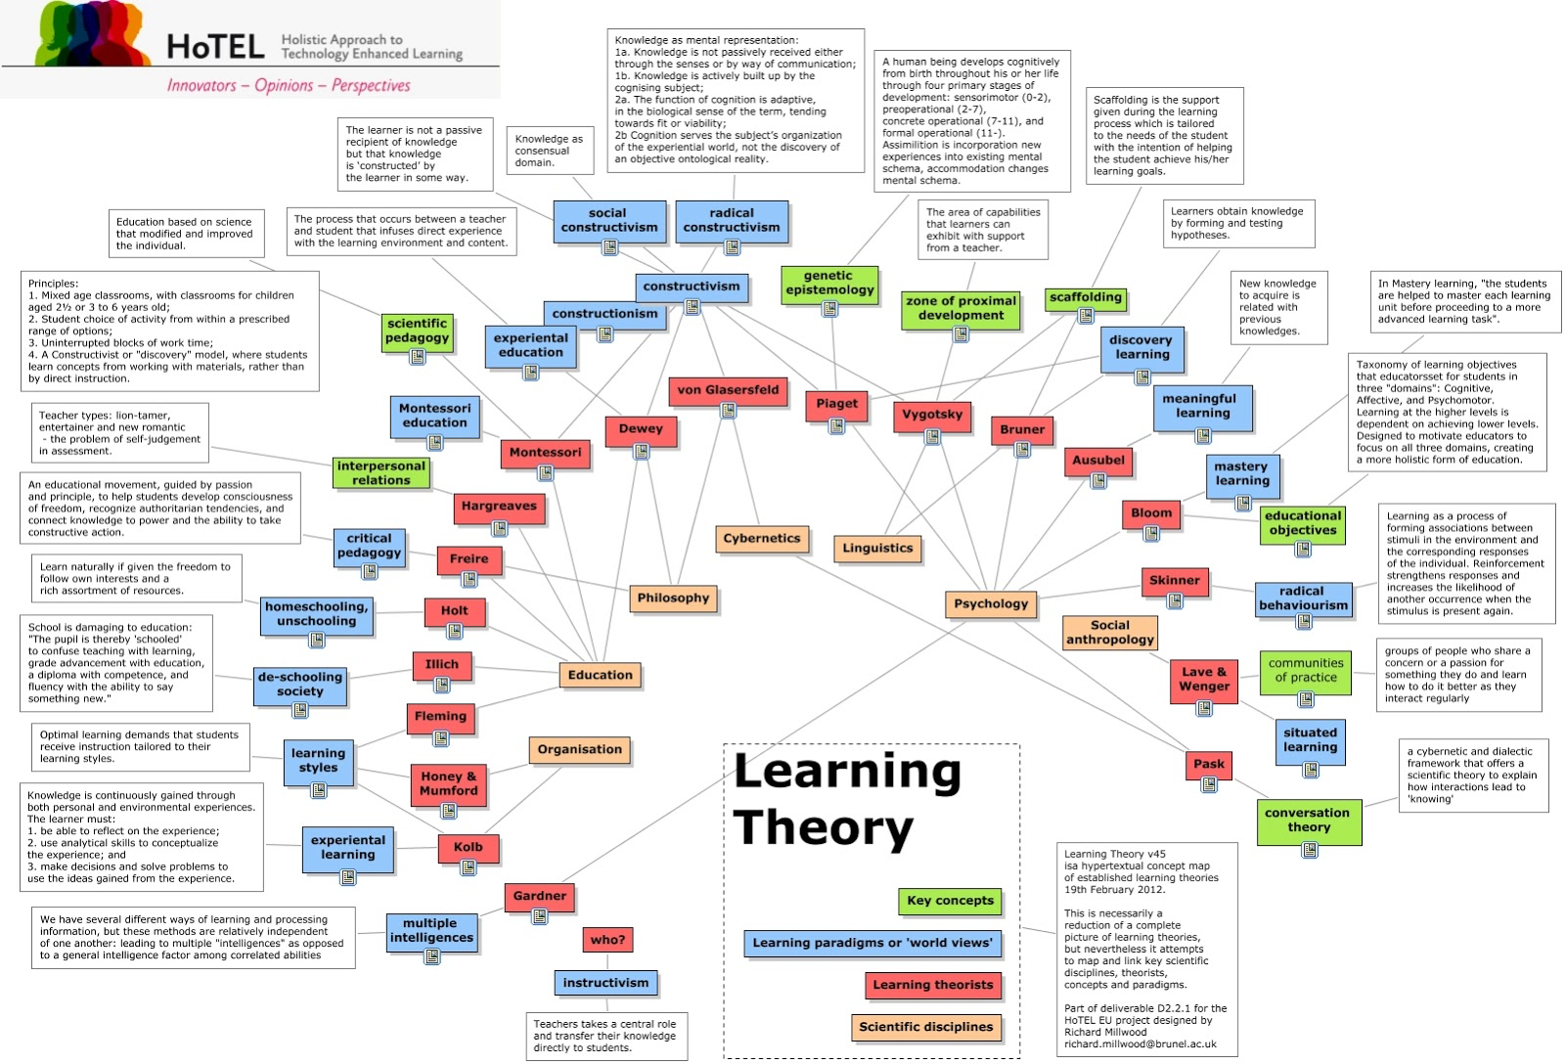
There is no universal theory of learning but evidence-based research results supporting some learning principles, which are today accepted and applied

Slide 14
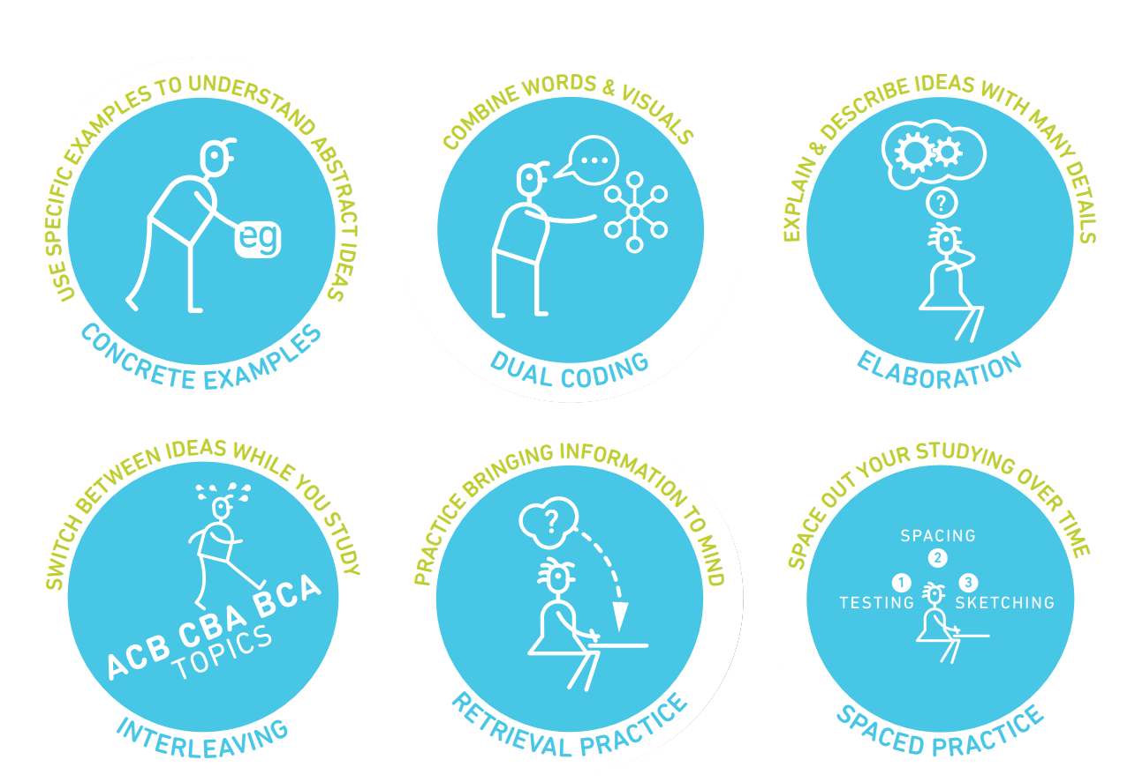
Six Strategies for effective learning (based on evidence from cognitive research)
Six Strategies for Effective Learning by Yana Weinstein, Megan Smith, & Oliver Caviglioli is licensed under a Creative Commons Attribution-NonCommercial-NoDerivatives 4.0 International License.
Based on a work at http://www.learningscientists.org, teachinghow2s.com/cogsci

Slide 15
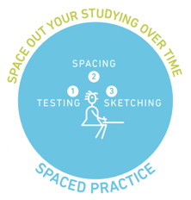



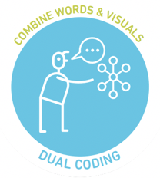
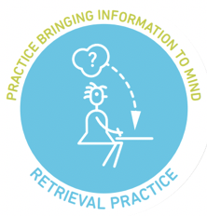
Learning strategy | Description
Spaced practice | Creating a study schedule that spreads study activities out over time
Interleaving | Switching between topics while studying
Elaboration | Asking and explaining why and how things work
Concrete examples | When studying abstract concepts, illustrating them with specific examples
Dual coding | Combining words with visuals
Retrieval practice | Bringing learned information to mind from long term memory

Slide 16
Challenge
How do you understand the 6 strategies for effective learning? (10 min)
Work in groups of three
Carefully read the strategies as a group
Pick one strategy you like (with no overlapping with the other groups)
Discuss how you would implement it as a teacher/instructor

Slide 17
7 Evidence Based Learning Principles
Principle P1: Students' prior knowledge can help or hinder learning.
Principle P2: How students organise knowledge influences how they learn and apply what
they know.
Principle P3: Students motivation determines, directs and sustains what they do learn.
Principle P4: To develop mastery, students must acquire component skills, practice integrating them, and know when to apply what they have learned
Principle P5: Goal-directed practice coupled with targeted feedback enhances the quality of
students' learning
Principle P6: Students' current level of development interacts with the social, emotional, and intellectual climate of the course to impact learning
Principle P7: To become self-directed learners, students must learn to monitor and adjust their approaches to learning.

Slide 18
Challenge
How do you understand the 7 principles of learning? (10 min)
Work in groups of three
Carefully read the principles as a group
Pick one principle that is not clear to you
Ask one question

Slide 19
Challenge
Teaching or Training? (3 + 3 min)
Based on your experience, what are in your opinion the differences between teaching and training?
Identify two main differences
Discuss them with your partner
Write them in the Gdoc (share them with us)

Slide 20
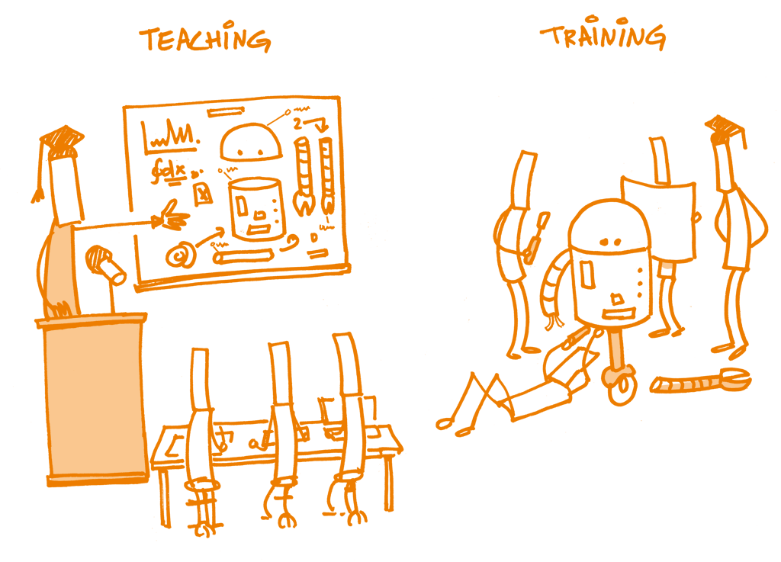
Open Science Training Handbook

Slide 21

How does learning progress?

Slide 22
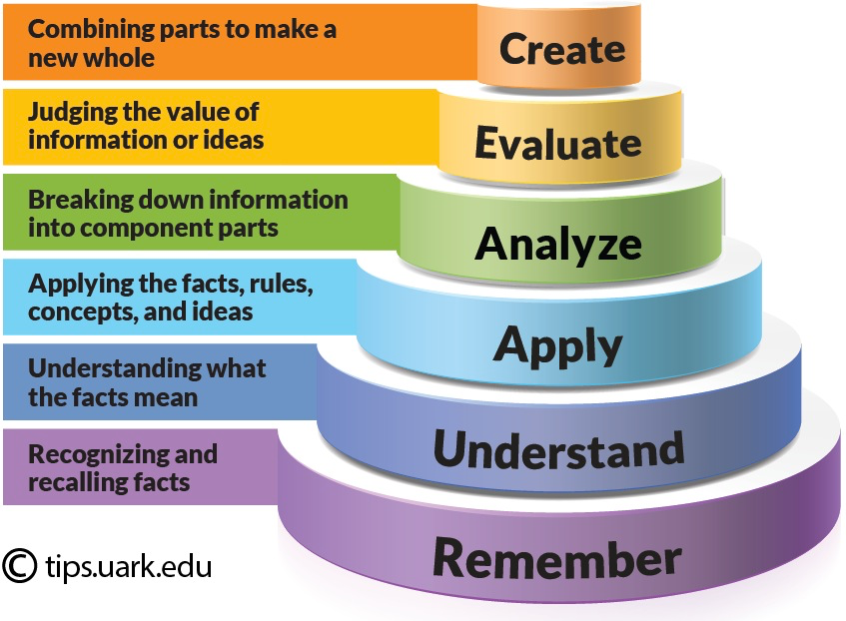
Bloom’s taxonomy
The Bloom's six categories of cognitive skills

Slide 23
We can use the Bloom's taxonomy to align instruction with learners' levels of complexity of thinking (and experience).
In practice, you can use the Bloom’s levels of cognitive complexity to:
write learning outcomes (LOs)
design instruction and learning experiences
assess learning

Slide 24
Instruction design in five steps
Select or identify LOs
Select learning experiences (LEs) that will help learners achieve LOs
Select content that is relevant to LOs
1
2
3
Evaluate the effectiveness of the LEs for leading learners to the LOs
Identify/develop assessments to ensure learner is progressing towards LOs
4
5

Slide 25
Learning outcomes (LOs)
LOs (more accurately “desired LOs”) are statements of what you might (in principle) assess.
You may not end up assessing all of them, but they are statements of what a successful* student will know or be able to do at the end of instruction

Slide 26
Learning outcomes (LOs)
By the end of the lesson (session/course/instruction) the successful learner will be able to.........

Slide 27
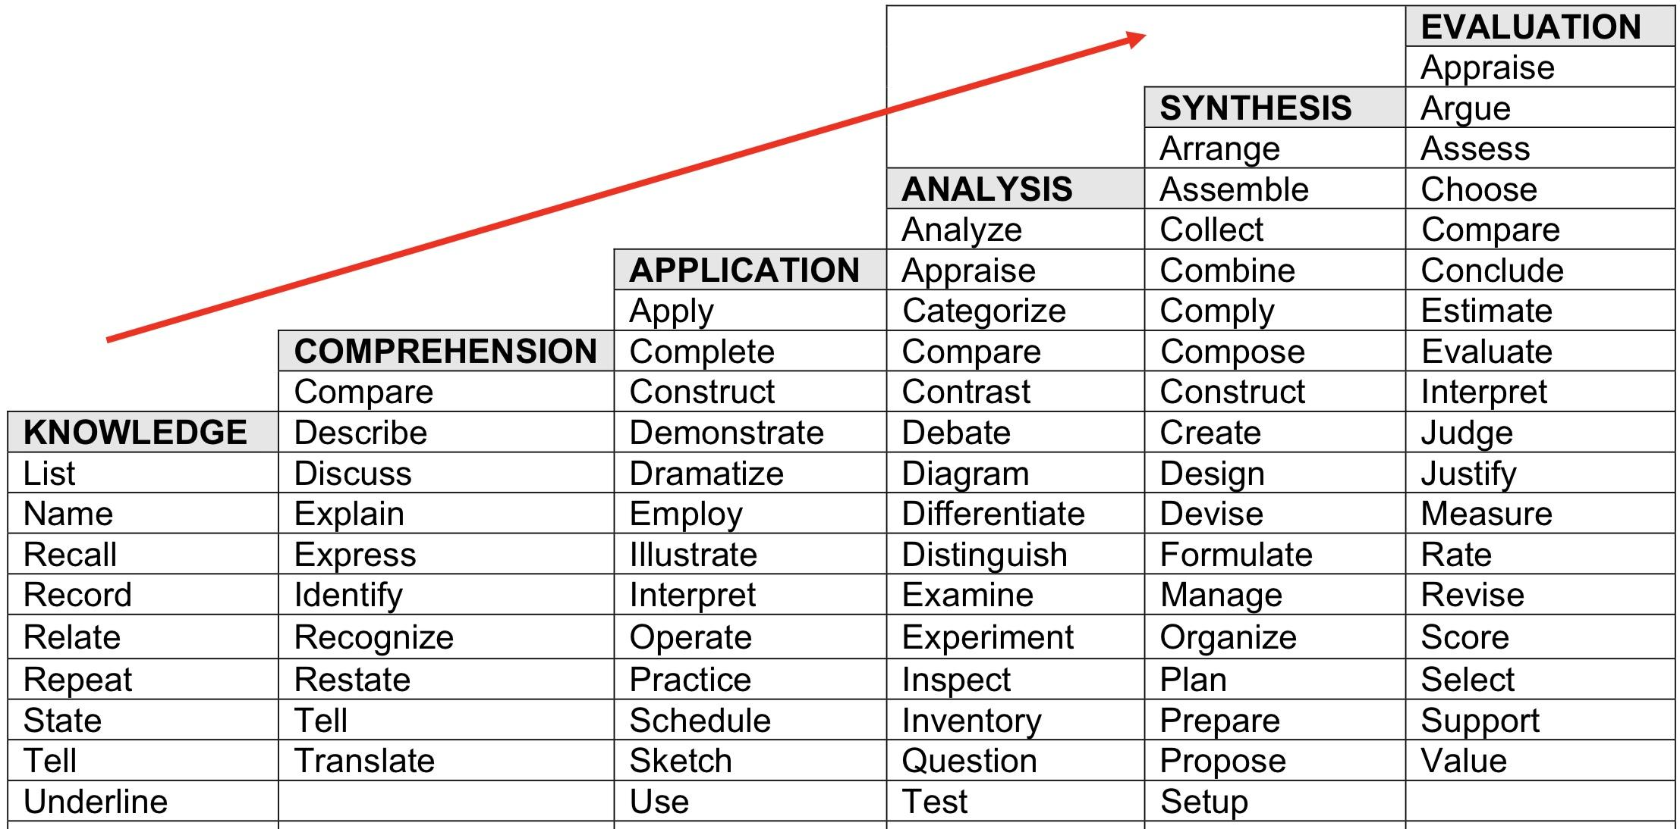
By the end of the lesson (session/course/instruction) the successful learner will be able to.........
Verbs that demonstrate Critical Thinking

Slide 28
Writing Learning Outcomes using assessable verbs
Think about what learners will be able to do by the end of instruction
Use the sentence:
By the end of the lesson (session/course/instruction) the successful learner will be able to.........
Replace dots with a verb that you can assess (name, explain, solve, distinguish, etc.).
Avoid verbs that are open to many interpretations: e.g., appreciate, have faith in, know, learn, understand, believe

Slide 29
Challenge
How do I write LOs?
Think of a lesson/session you usually deliver
Write one or more Learning Outcomes for the lesson/session
Write to the GDoc the title of the lesson/session and the corresponding LO(s)

Slide 30
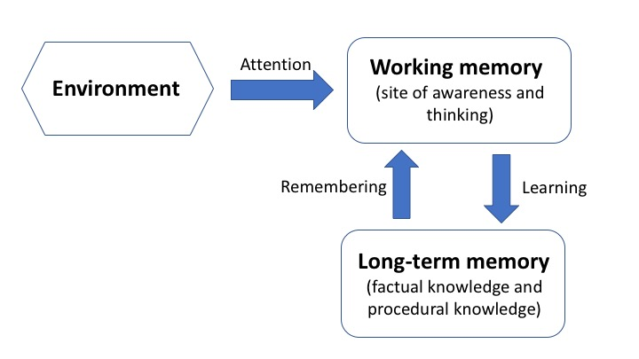
Working memory, long term memory and learning

Slide 31
Working memory, long term memory and learning
Full of things to see and hear, problem to be solved etc.

Slide 32
Working memory, long term memory and learning
Component of your mind (synonymous of consciousness). It is where thinking occurs. It is the part of your mind where you are aware of what is around you.
Full of things to see and hear, problem to be solved etc.

Slide 33
Working memory, long term memory and learning
Component of your mind (synonymous of consciousness). It is where thinking occurs. It is the part of your mind where you are aware of what is around you.
Full of things to see and hear, problem to be solved etc.
Vast storehouse in which you mantain your factual knowledge of the world. Information in long-term memory resides outside of awareness.

Slide 34
Working memory, long term memory and learning
Very fast but has very limited space. Several experiments showed that we can hold in the working memory up to 7 +/- 2 items.

Slide 35
Working memory, long term memory and learning
Long-term memory is slow to access but it is essentially unbounded

Slide 36
Challenge: short term memory
How many words do you remember?

Slide 37
Challenge: (Willingham, 2009):
How many consecutive letters can you remember?
X C N
N P H
D F B
I C I
A N C
A A X

Slide 38
Challenge: (Willingham, 2009):
How many consecutive letters can you remember?
write them down

Slide 39
Challenge: (Willingham, 2009):
What about now?
X
C N N
P H D
F B I
C I A
N C A A
X

Slide 40
Challenge: (Willingham, 2009):
How many consecutive letters can you remember?
write them down

Slide 41
The amount of space in working memory does not depend on the number of letters; it depends on the number of meaningful objects.

Slide 42
What can we do to make room in working memory?

Slide 43
What can we do to make room in working memory?
Chunking

Slide 44
What can we do to make room in working memory?
Chunking
Increase background knowledge
Avoid extraneous cognitive load

Slide 45
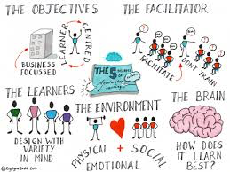
Increase background knowledge
Principle P1: Students' prior knowledge can help or hinder learning

Slide 46
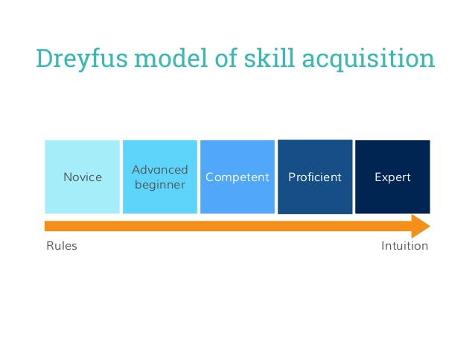
How does learning progress?

Slide 47
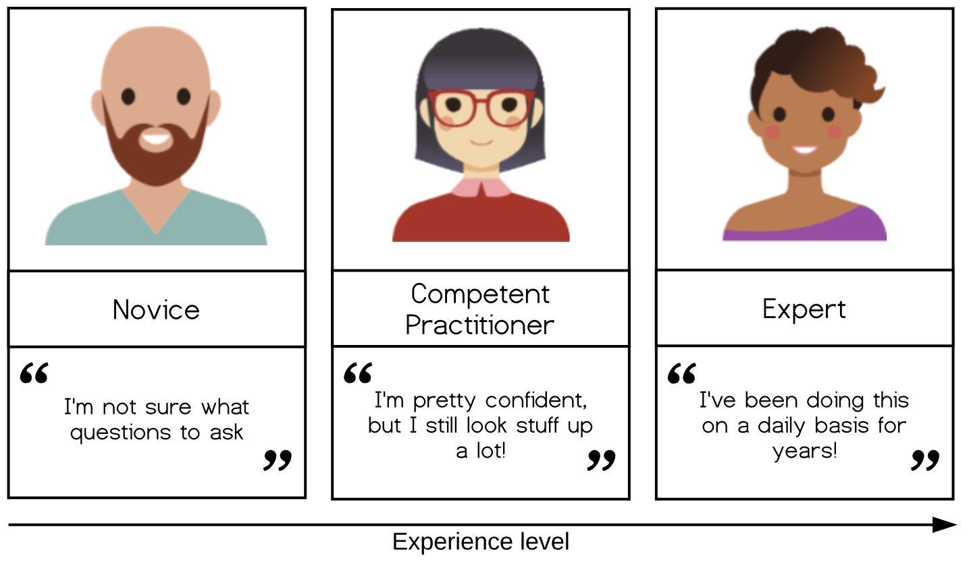
The Carpentries model of skill acquisition
Notes:
Novice: someone who doesn’t even know what questions to ask.
Competent practitioner: someone who has enough understanding for everyday purposes. They won’t know all the details of how something works and their understanding may not be entirely accurate, but it is sufficient for completing normal tasks with normal effort under normal circumstances.
Expert: someone who can easily handle situations that are out of the ordinary.

Slide 48
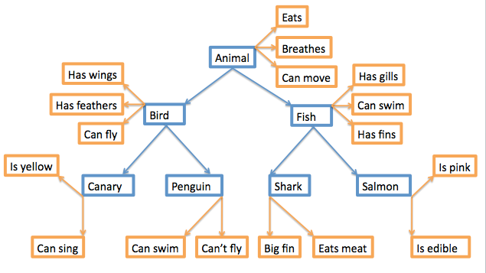
Mental models
A collection of concepts and facts, along with the relationships between those concepts, that a person has about a topic or field.
It is how people organise their knowledge.
You can think of a graph with nodes (facts, concepts) and edges (connections).

Slide 49
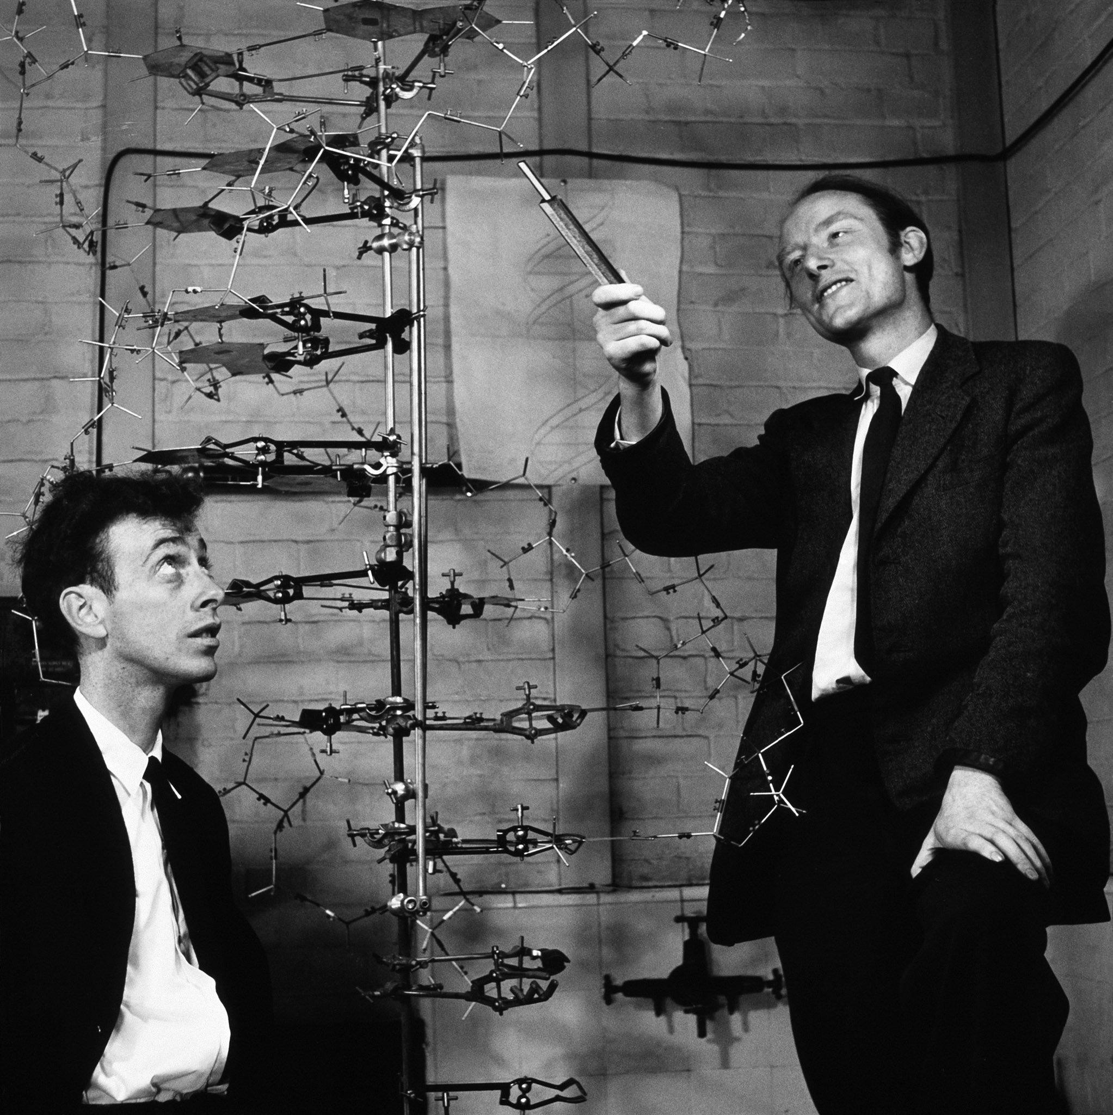

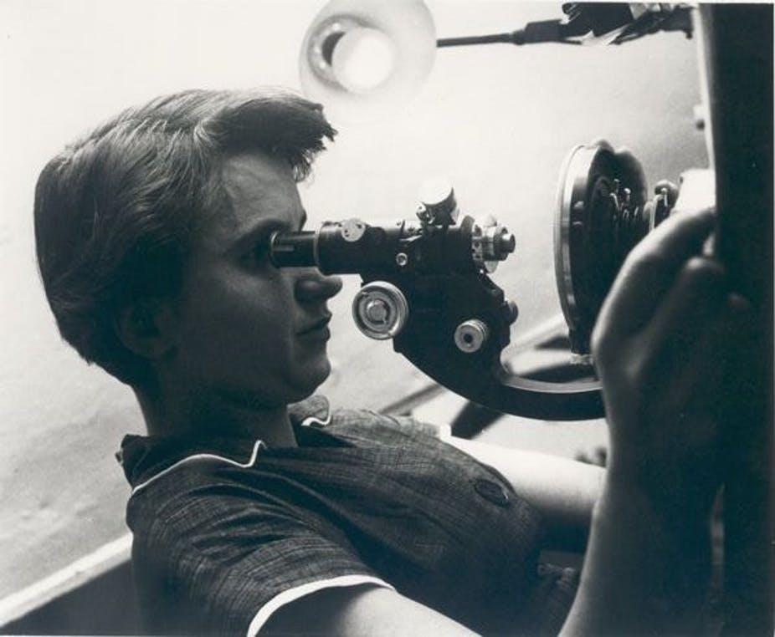
(mental) model of DNA

Slide 50
Novice vs Competent Practitioner vs Expert
A novice, typically has not yet built a mental model of the field.
A competent practitioner has a mental model that works for many purposes, but will not be very accurate.
Experts’ mental models are much more densely connected. Therefore they can jump directly from a problem to its solution because there is a direct link between the two in their mind

Slide 51
What facilitates learning?
It is not only a matter of knowledge
Help novices build a mental model
Help learners make connections
Detect and remediate misconceptions
Be aware of the limitations of expertise
- expert blind spot
- fluid representations

Slide 52
3 main classes of misconceptions
Simple factual errors: These are the easiest to correct.
Broken models: We can address these by having learners reason through examples to see contradictions.
Fundamental beliefs: These beliefs are deeply connected to the learner’s social identity and are the hardest to change.

Slide 53
What can we do to make room in working memory?
Chunking
Increase background knowledge
Avoid extraneous cognitive load

Slide 54
Cognitive load
Intrinsic cognitive load is the effort associated with a specific topic.
Germane cognitive load it is the (desirable) mental effort required to create linkages between new information and old.
Extraneous cognitive load is everything else that distracts or gets in the way. Extraneous cognitive load refers to the way information or tasks are presented to a learner.
Notes:
Germane cognitive load refers to the work put into creating a permanent store of knowledge, or a schema. It is the (desirable) mental effort required to create linkages between new information and old (which is one of the things that distinguishes learning from memorization)

Slide 55

Attention split effect
Split-attention occurs when learners are required to split their attention between at least two sources of information that have been separated either spatially or temporally

Slide 56
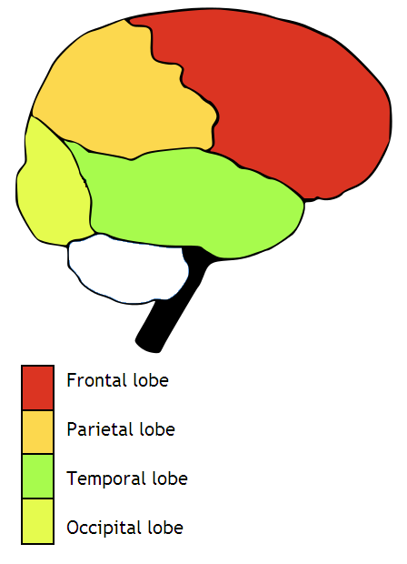
Attention split effect

Slide 57
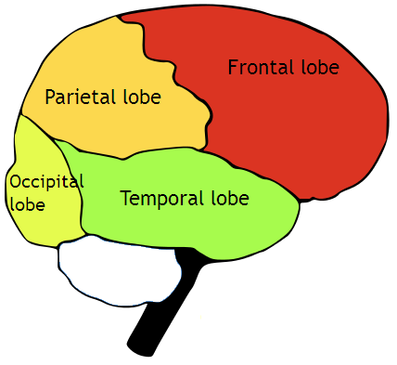
Attention split effect

Slide 58
Challenge: Extraneous cognitive load (10 min)
Think of the tasks you teach in your lessons/courses. Pick one.
What would be the extraneous load in performing this task. How can you avoid it?
Discuss with your partner(s).

Slide 59
Time to relax

Slide 60
Other factors facilitating memory and learning (Willingham, 2009)
1. things that create an emotional reaction will be better remembered, but emotion is not necessary for learning (and it is definitely not sufficient!)
2. if you don't pay attention to something, you can't learn it
3. repetition helps but repetition alone is not sufficient
4. wanting to remember something has little or no effect
5. thinking about meaning is good for memory
6. practice makes learning long lasting
7. spaced practice is of great benefit for memory

Slide 61
Other factors facilitating memory and learning (Willingham, 2009)
1. things that create an emotional reaction will be better remembered, but emotion is not necessary for learning (and it is definitely not sufficient!)
2. if you don't pay attention to something, you can't learn it
3. repetition helps but repetition alone is not sufficient
4. wanting to remember something has little or no effect
5. thinking about meaning is good for memory
6. practice makes learning long lasting
7. spaced practice is of great benefit for memory

Slide 62
Other factors facilitating memory and learning (Willingham, 2009)
1. things that create an emotional reaction will be better remembered, but emotion is not necessary for learning (and it is definitely not sufficient!)
2. if you don't pay attention to something, you can't learn it
3. repetition helps but repetition alone is not sufficient
4. wanting to remember something has little or no effect
5. thinking about meaning is good for memory
6. practice makes learning long lasting
7. spaced practice is of great benefit for memory

Slide 63
Other factors facilitating memory and learning (Willingham, 2009)
1. things that create an emotional reaction will be better remembered, but emotion is not necessary for learning (and it is definitely not sufficient!)
2. if you don't pay attention to something, you can't learn it
3. repetition helps but repetition alone is not sufficient
4. wanting to remember something has little or no effect
5. thinking about meaning is good for memory
6. practice makes learning long lasting
7. spaced practice is of great benefit for memory

Slide 64
Other factors facilitating memory and learning (Willingham, 2009)
1. things that create an emotional reaction will be better remembered, but emotion is not necessary for learning (and it is definitely not sufficient!)
2. if you don't pay attention to something, you can't learn it
3. repetition helps but repetition alone is not sufficient
4. wanting to remember something has little or no effect
5. thinking about meaning is good for memory
6. practice makes learning long lasting
7. spaced practice is of great benefit for memory

Slide 65
Other factors facilitating memory and learning (Willingham, 2009)
1. things that create an emotional reaction will be better remembered, but emotion is not necessary for learning (and it is definitely not sufficient!)
2. if you don't pay attention to something, you can't learn it
3. repetition helps but repetition alone is not sufficient
4. wanting to remember something has little or no effect
5. thinking about meaning is good for memory
6. practice makes learning long lasting
7. spaced practice is of great benefit for memory

Slide 66
Other factors facilitating memory and learning (Willingham, 2009)
1. things that create an emotional reaction will be better remembered, but emotion is not necessary for learning (and it is definitely not sufficient!)
2. if you don't pay attention to something, you can't learn it
3. repetition helps but repetition alone is not sufficient
4. wanting to remember something has little or no effect
5. thinking about meaning is good for memory
6. practice makes learning long lasting
7. spaced practice is of great benefit for memory

